Slide 1
CRYPTOGRAPHY
Stream Ciphers

Slide 2
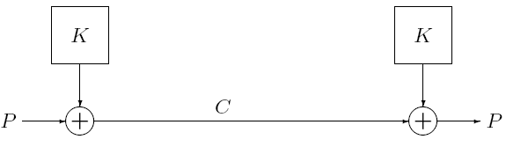
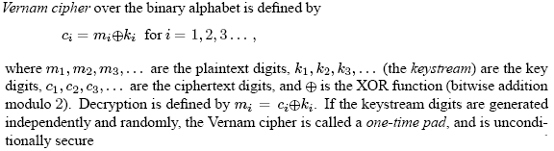
The One-Time Pad

Slide 3
One-Time Pad or Vernam Cipher
Example: Let the message be IF then its ASCII code be
(1001001 1000110) and the key be (1010110 0110001).
The ciphertext can be found XORing message and key bits
Encryption:
1001001 1000110 plaintext
1010110 0110001 key
0011111 1110110 ciphertext
Decryption:
0011111 1110110 ciphertext
1010110 0110001 key
1001001 1000110 plaintext

Slide 4
Why One-Time Pad is provably secure?
Or how can we prove it is unbreakable?
The security depends on the randomness of the key.
It is hard to define randomness.
In cryptographic context, we seek two fundamental properties in a binary random key sequence:
Unpredictability: Independent of the number of the bits of a sequence observed, the probability of guessing the next bit is not better than ½. Therefore, the probability of a certain bit being 1 or 0 is exactly equal to ½.
Balanced (Equal Distribution): The number of 1’s and 0’s should be equal.

Slide 5
The One-Time Pad
Drawback
An obvious drawback of the one-time pad is that key should be as long as the plaintext message which increases the difficulty of key distribution and key management
That motivates the design of stream ciphers where the keystream is pseduorandomly generated from a smaller secret key, with the intent that the key stream appears to a computationally bounded adversary

Slide 6
Stream Ciphers
Process message bit by bit or byte by byte (as a stream)
Have a pseudo random keystream
Combined (XOR) with plaintext bit by bit
Randomness of key stream completely destroys statistically properties in message
But must never reuse stream key
Otherwise can recover messages

Slide 7
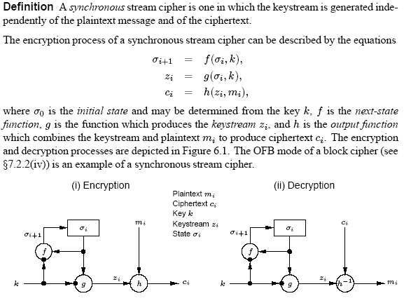
Synchronous Stream Cipher

Slide 8
Synchronous Stream Cipher
Properties of synchronous stream ciphers
synchronization requirements.
both the sender and receiver must be synchronized – using the same key and operating at the same position (state) within that key – to allow for proper decryption.
If synchronization is lost due to ciphertext digits being inserted or deleted during transmission, then decryption fails and can only be restored through additional techniques for re-synchronization.
no error propagation.
A ciphertext digit that is modified (but not deleted) during transmission does not affect the decryption of other ciphertext digits.
active attacks.
the insertion, deletion, or replay of ciphertext digits by an active adversary causes immediate loss of synchronization, and hence might possibly be detected by the decryptor.
an active adversary might possibly be able to make changes to selected ciphertext digits, and know exactly what affect these changes have on the plaintext.

Slide 9
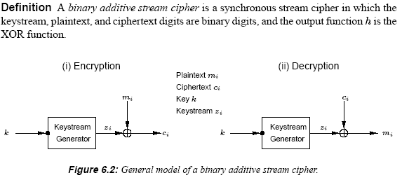
Synchronous Stream Cipher

Slide 10
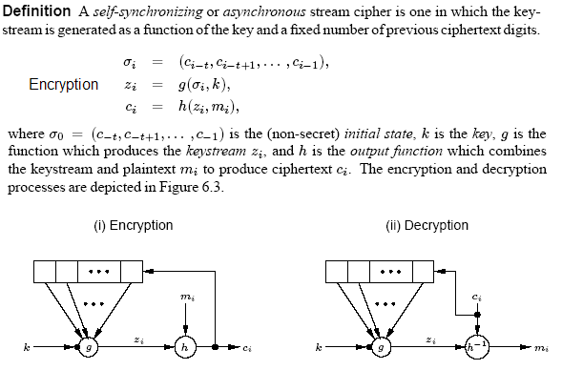
Asynchronous Stream Cipher

Slide 11
Asynchronous Stream Cipher
Properties of Asynchronous stream ciphers
self-synchronization.
capable of re-establishing proper decryption automatically after loss of synchronization, with only a fixed number of plaintext characters unrecoverable.
Limited error propagation.
state of a self-synchronization stream cipher depends on t previous ciphertext digits.
If a single ciphertext digit is modified (or even deleted or inserted) during transmission, then decryption of up to t subsequent ciphertext digits may be incorrect, after which correct decryption resumes.
active attacks.
any modification of ciphertext digits by an active adversary causes several other ciphertext digits to be decrypted incorrectly, thereby improving (compared to synchronous stream ciphers) the likelihood of being detected by the decryptor.
it is more difficult (than for synchronous stream ciphers) to detect insertion, deletion, or replay of ciphertext digits by an active adversary.
diffusion of plaintext statistics
Since each plaintext digit influences the entire following ciphertext, the statistical properties of the plaintext are dispersed through the ciphertext. Hence, self-synchronizing stream ciphers may be more resistant than synchronous stream ciphers against attacks based on plaintext redundancy.

Slide 12
Linear Feedback Shift Register - LFSR
Output sequence
bn
bn-1
b2
b1
Feedback Function
A feedback shift register is made up of two parts: a shift register and a feedback function
The shift register is a sequence of bits, if it is n-bit long, it is called n bit shift register
Each time a bit is needed, all bits in the shifted register are shifted 1 bit to right
The new leftmost bit is computed as a function of the other bits using feedback function
The output of shift register is 1 bit, often least significant bit
The period of a shift register is the length of the output sequence before it starts repeating itself.

Slide 13
Linear Feedback Shift Register - LFSR
Output bit
bn
bn-1
…………
b2
b1
The simplest kind of feedback shift register is a linear feedback shift register (LFSR), the feedback function is simply XOR of certain bits in the register, the list of these bits is called a tap sequence
Output bit
b4
b3
b2
b1

Slide 14
Linear Feedback Shift Register - LFSR
Example: 4-bit LFSR tapped at first and fourth bit
It is initialized with the value 1 1 1 1
It produces the bit sequence
The output sequence is the string of least significant bits
1 1 1 1 0 1 0 1 1 1 0 0 1 0 0 0 . ………..
An n-bit LFSR maximum cycle through 2^{n}-1 states-these are maxima; period LFSRs and the resulting output sequence is called m-sequence
1 1 1 1
0 1 1 1
1 0 1 1
0 1 0 1
1 0 1 0
1 1 0 1
0 1 1 0
0 0 1 1
1 0 0 1
0 1 0 0
0 0 1 0
0 0 0 1
1 0 0 0
1 1 0 0
1 1 1 0
Output bit
b4
b3
b2
b1

Slide 15
Linear Feedback Shift Register - LFSR
In order for a particular LFSR to be maximal-period LFSR, the polynomial formed from a tap sequence plus the constant 1, must be a primitive polynomial mod 2.
c1 c2 cL
denoted by < L , C(D) > where, the degree of the polynomial is the length of the shift register
Singular LFSR
Non-Singular LFSR
Notes:
Low degree term in the polynomial corresponds to tap near the left hand side of the register.

Slide 16
Linear Feedback Shift Register - LFSR
Example: Consider the LFSR <4, 1+D+ D⁴ > with initial state [0 ,1, 1, 0]
0 1 1 0
0 0 1 1
1 0 0 1
0 1 0 0
0 0 1 0
0 0 0 1
1 0 0 0
1 1 0 0
1 1 1 0
1 1 1 1
0 1 1 1
1 0 1 1
0 1 0 1
1 0 1 0
1 1 0 1
0 1 1 0
Output bit
D
D²
D³
D⁴
Low degree term in the polynomial corresponds to tap near the left hand side of the register.
The output sequence is :
0 1 1 0 0 1 0 0 0 1 1 1 1 0 1 …….

Slide 17
Linear Feedback Shift Register - LFSR
Every output sequence (i.e., for all possible initial states) of an LFSR <L,C(D)> is periodic if and only if the connection polynomial C(D) has degree L.
Periods of LFSR output sequence
Let be a connection polynomial of degree L.
If C(D) is irreducible over Z₂ , then each of the 2^{L} − 1 nonzero initial states of the non-singular LFSR <L,C(D)> produces an output sequence with period equal to the least positive integer N such that C(D) divides 1 + D^{N} in Z₂[D]. (Note: it is always the case that this N is a divisor of 2^{L} − 1.)
If C(D) is a primitive polynomial , then each of the 2^{L}−1 nonzero initial states of the non-singular LFSR <L,C(D)> produces an output sequence with maximum possible period 2^{L} − 1.
If is a primitive polynomial of Degree L, then <L,C(D)> is called a maximum-length length LFSR. The output of maximum length LFSR with non-zero initial state is called an m-sequence.

